Slide 1
UNIVERSITY SOCIAL NETWORK DATABASE SYSTEM
DAMG 6205 36505 GROUP NO: 20
Team Members
NUID | Name
002774017 | Aditya Ramesh Mysore
002775775 | Anwesh Peddineni
002658318 | Payal Nagaonkar
002651513 | Ritika Mangamuru
002658318 | Smrithi Jagithyala

Slide 2
PURPOSE/OBJECTIVES
This is a platform that aims to connect students and professors who share similar research interests.
It facilitate networking opportunities for students based on their career goals, coursess, and extracurricular interests.
Additionally, the platform provides a space for students to discuss university-related issues.
Also offers a channel for employers and recruiters to connect with potential candidates.

Slide 3
Entities and their respective attributes
Employer(subtype of User)
Employer ID
Location
Student (subtype of User)
Student ID
Major
User (generalized entity)
UserID
Name
Date Of Birth
Age
Gender
Username
Password
Type
PostLike
Like_TimeStamp
UserID
Post ID
Group(subtype of User)
Group ID
Type
CreationDate
Professor(subtype of User)
Professor ID
Research Interest
Comment
Comment ID
UserID
Post ID
Comment
Cmt_Time Stamp
Marketplace Post
MPostID
Type
Price
Availability
CommentLike
Cmt_like_TimeStamp
UserID
CommentID
Post
Post ID
Description
TimeStamp
General Post
GPostID
Category

Slide 4
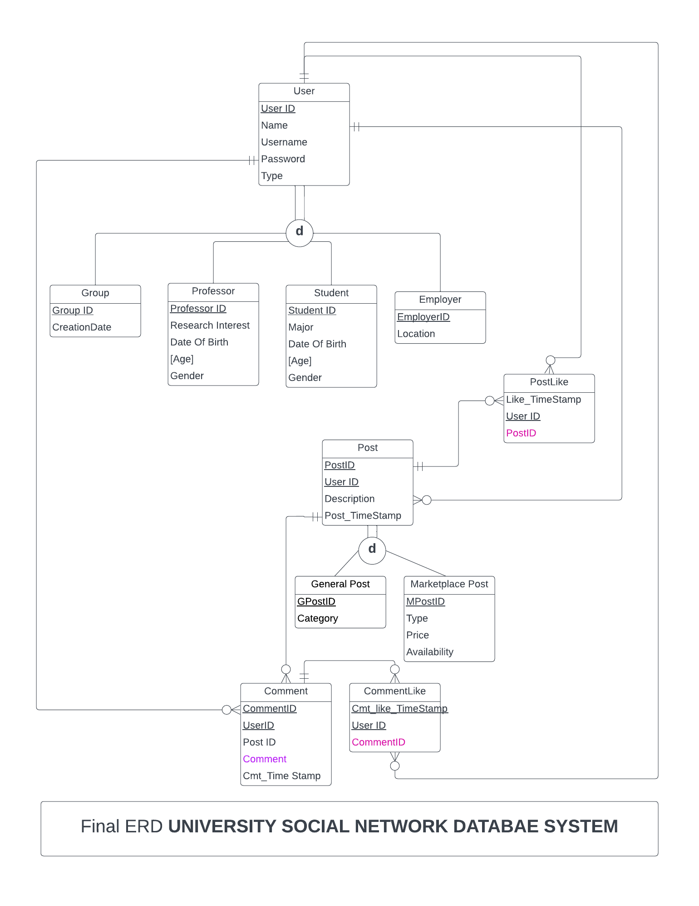
Key Decisions:
The User entity is a generalized entity with subtypes such as Student, Professor, Employer, and Group. These subtypes inherit attributes and relationships from the User entity.
A Group can have its user account and can perform actions like posting, commenting, and liking related to specific topics.
Each Student will be under a Major and each professor will have a research interest which helps in personalizing the user’s feed.
Items that users want to sell should be posted as a part of the Marketplace Post which is separated from general post.
Tools:
• Data Model: MS-SQL
• Visualization Tool: Tableau
• Others: SQL server,Azure Data Studio

Slide 5
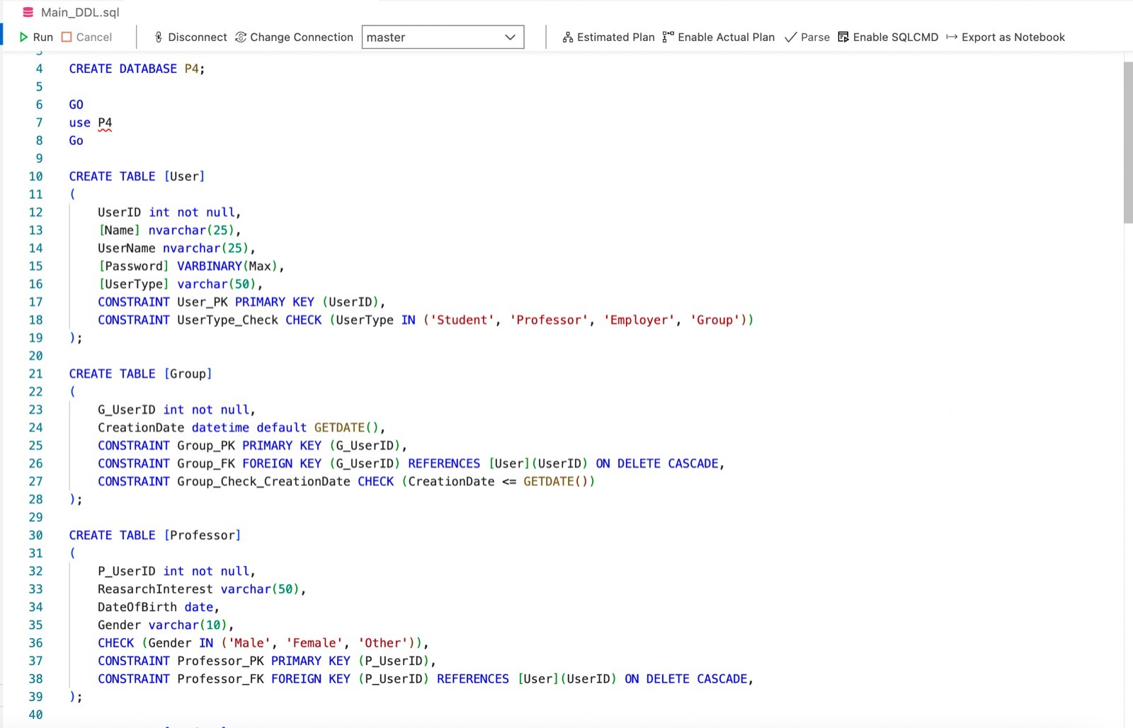
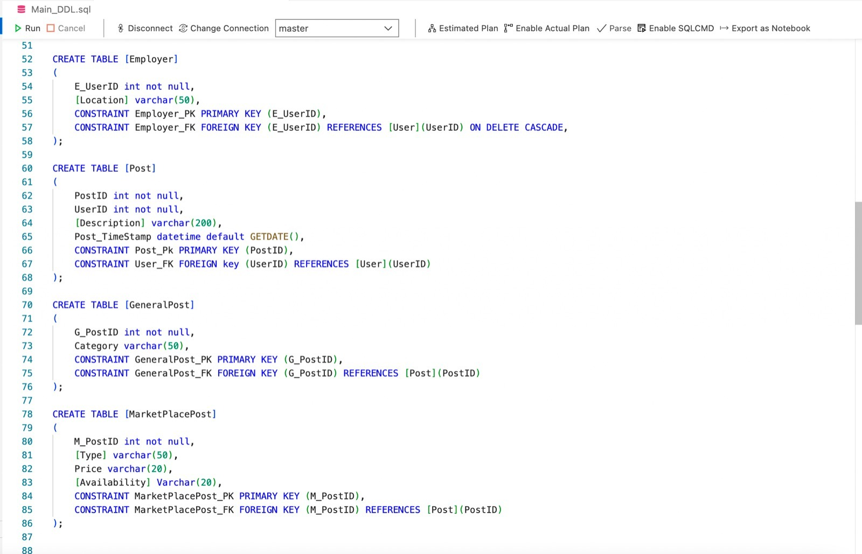
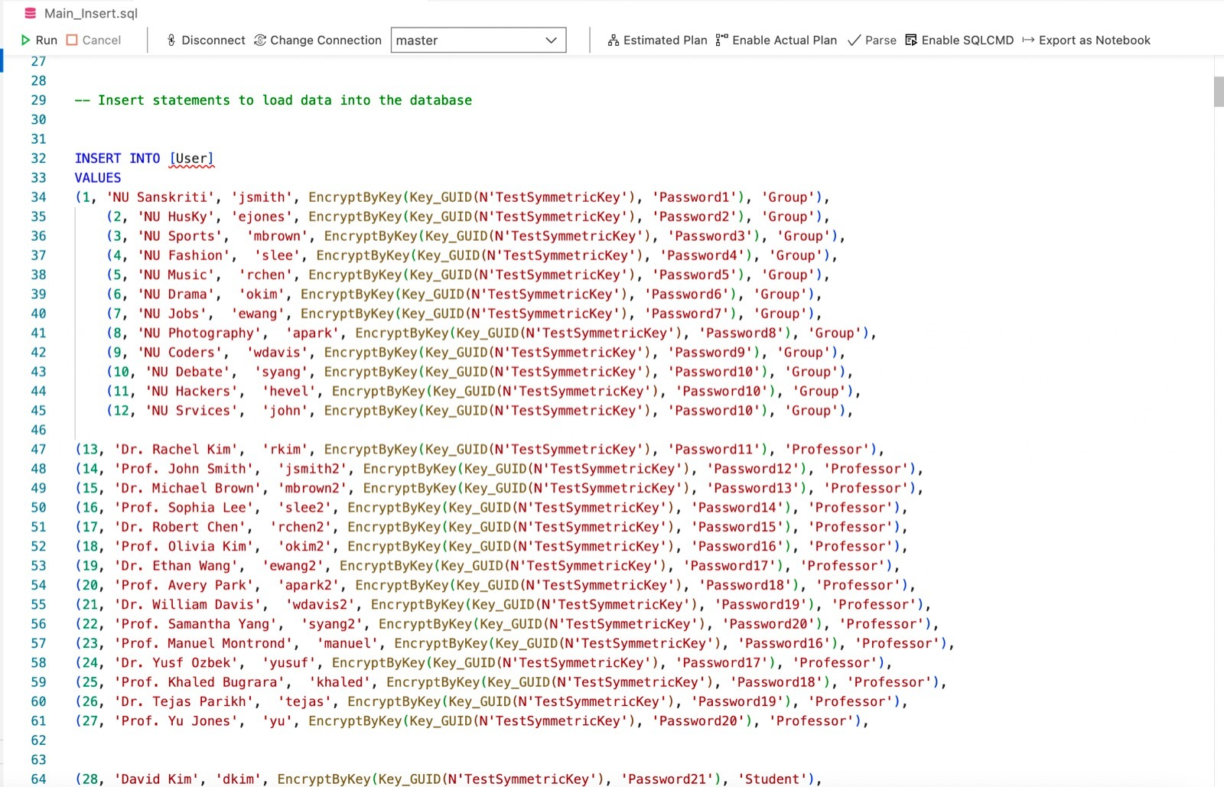
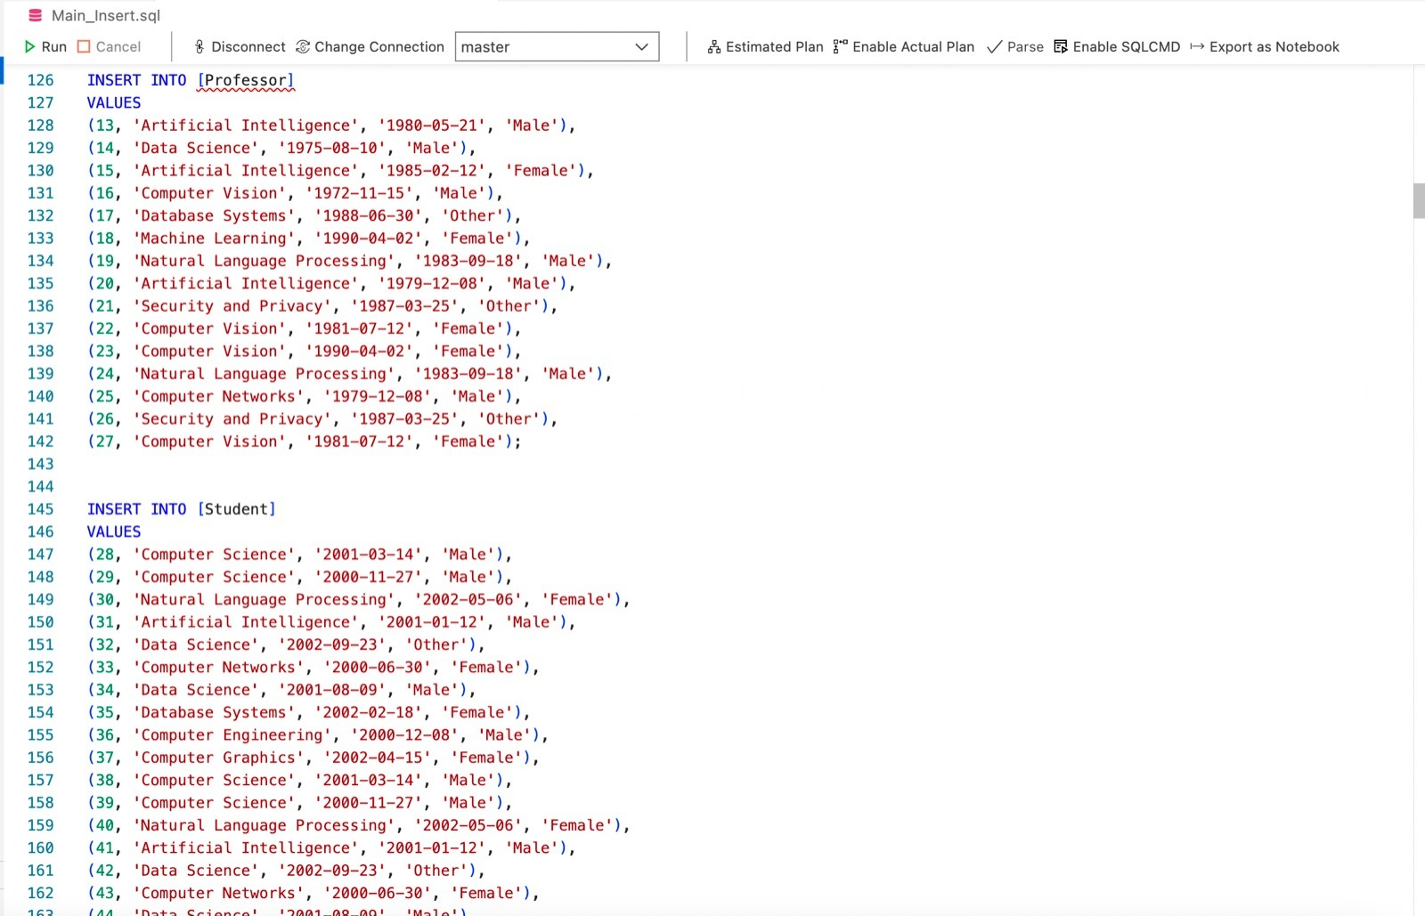
SQL DDL CREATE AND INSERT STATEMENTS

Slide 6
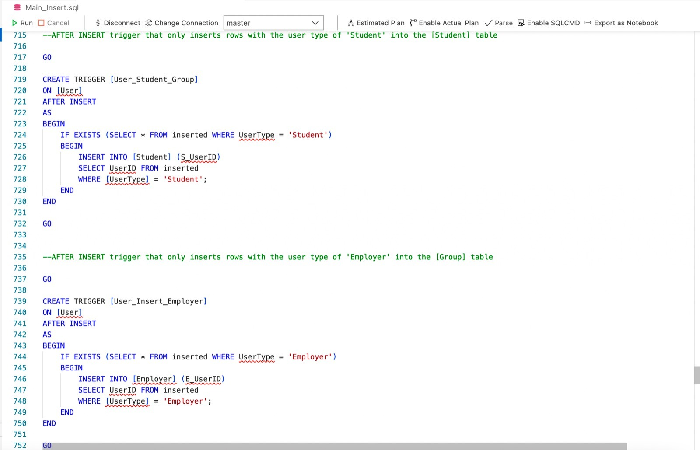
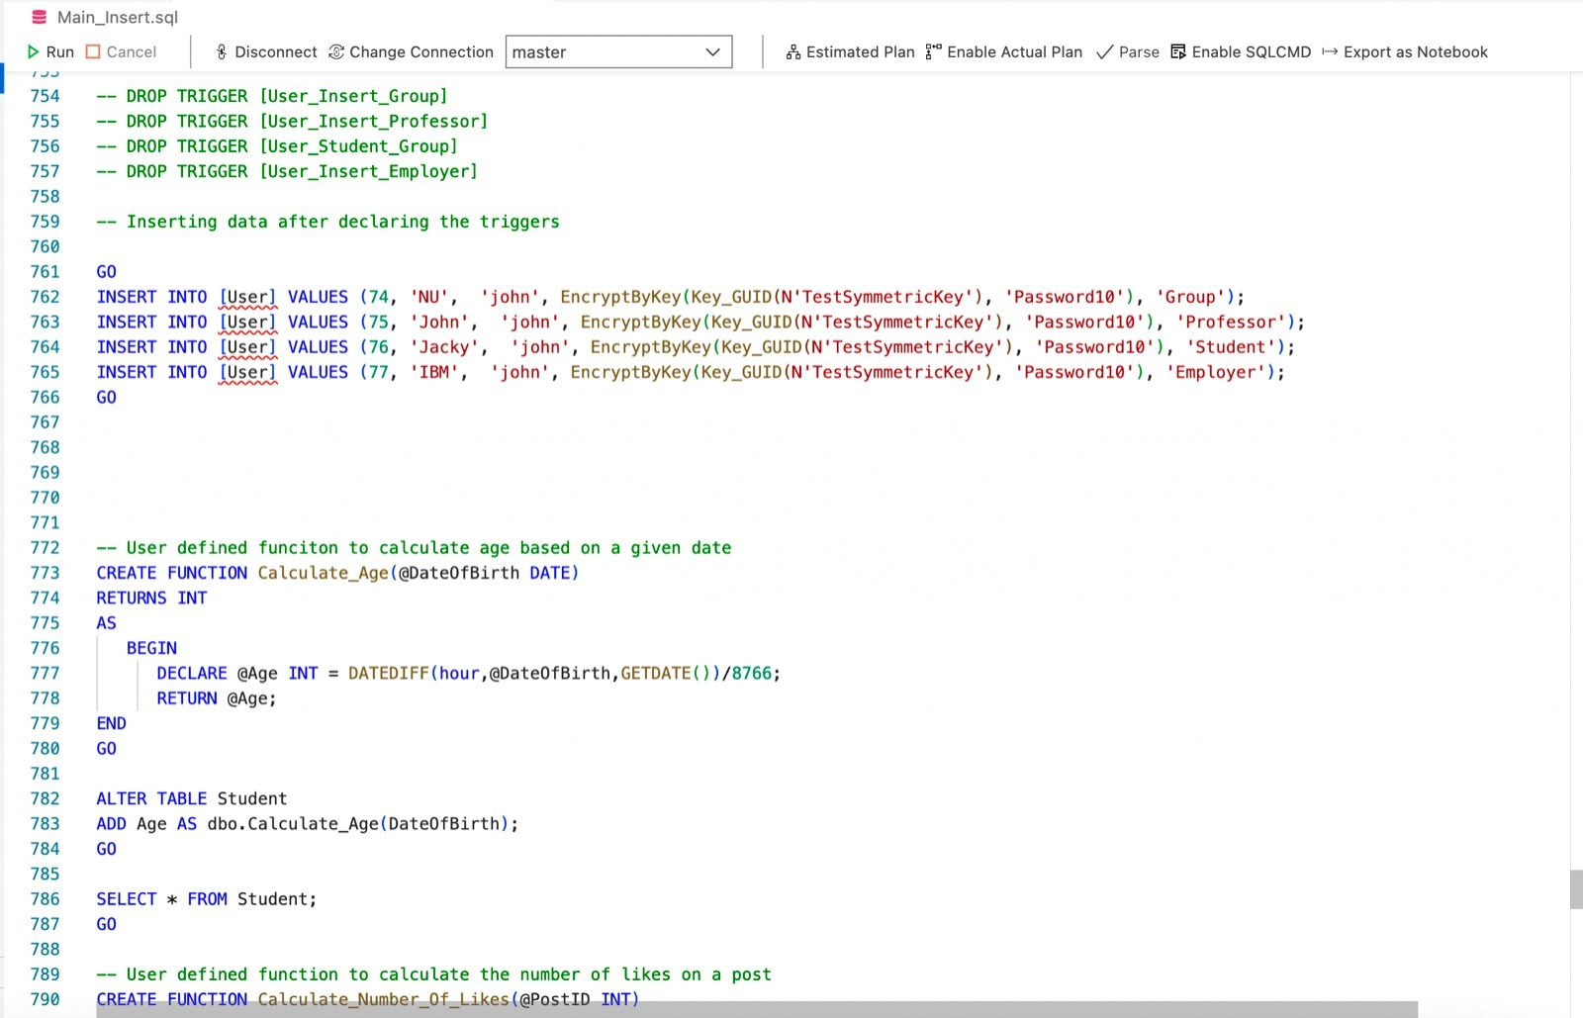
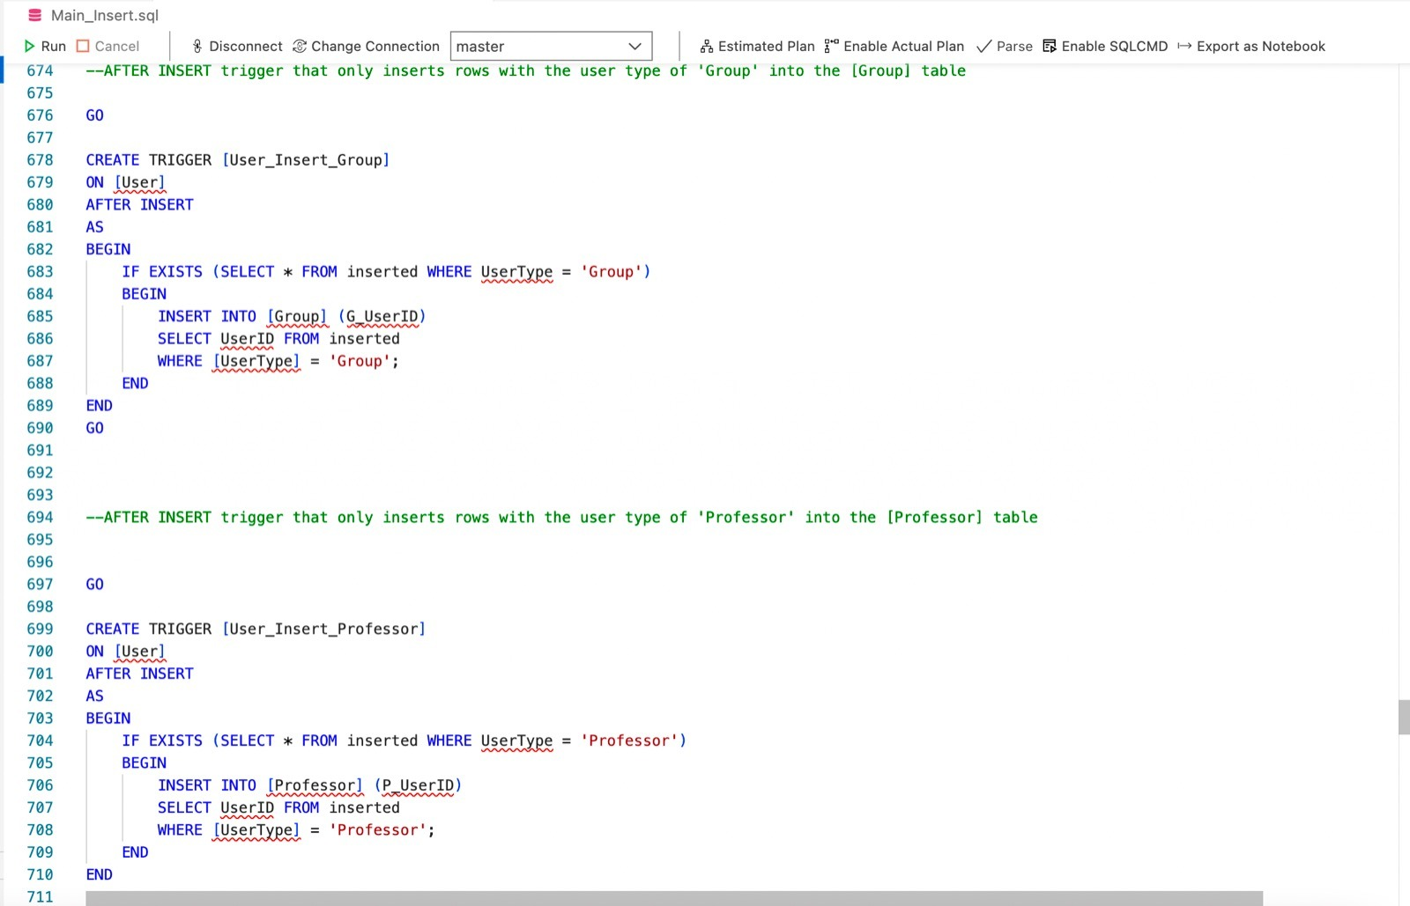
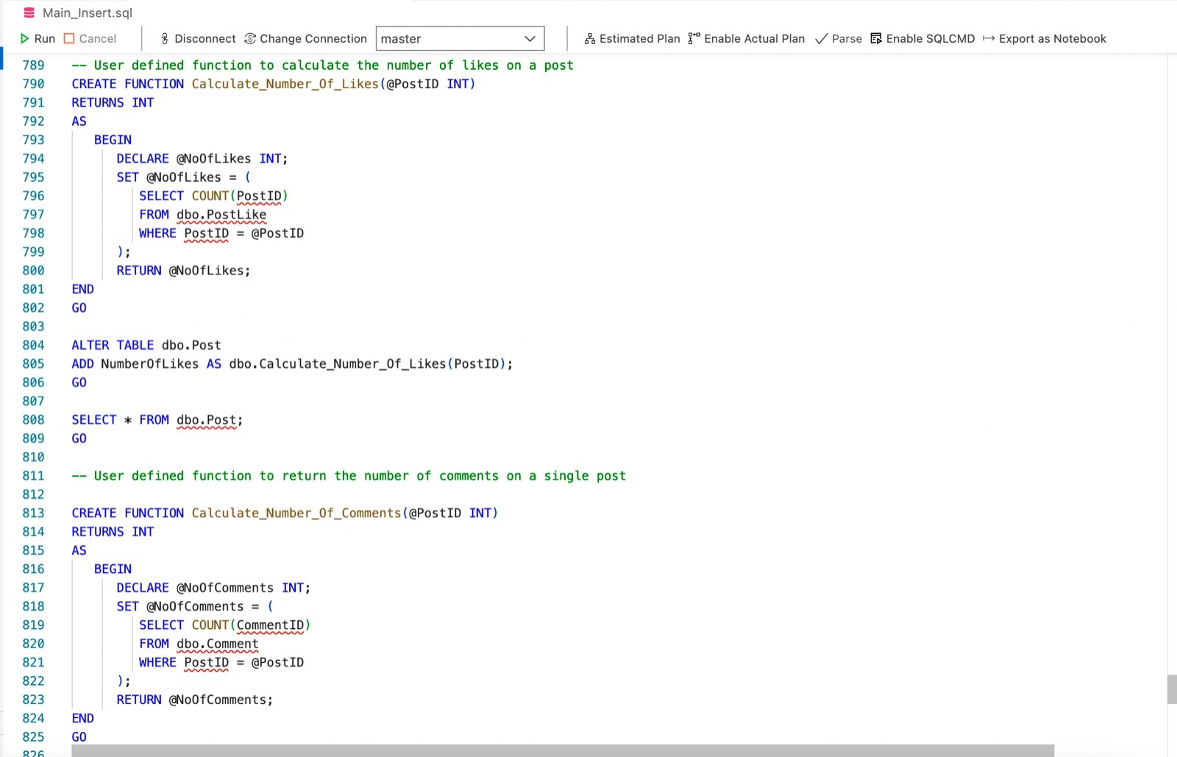
SQL TRIGGER
SQL COMPUTED FUNCTIONS

Slide 7
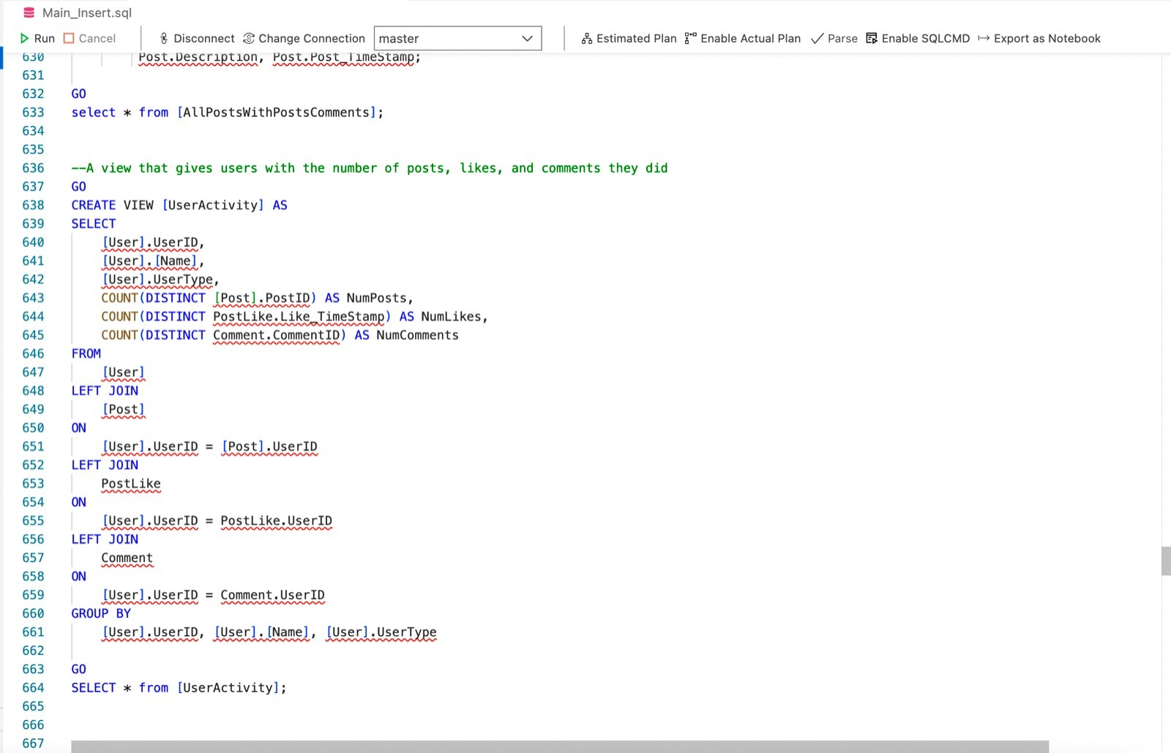
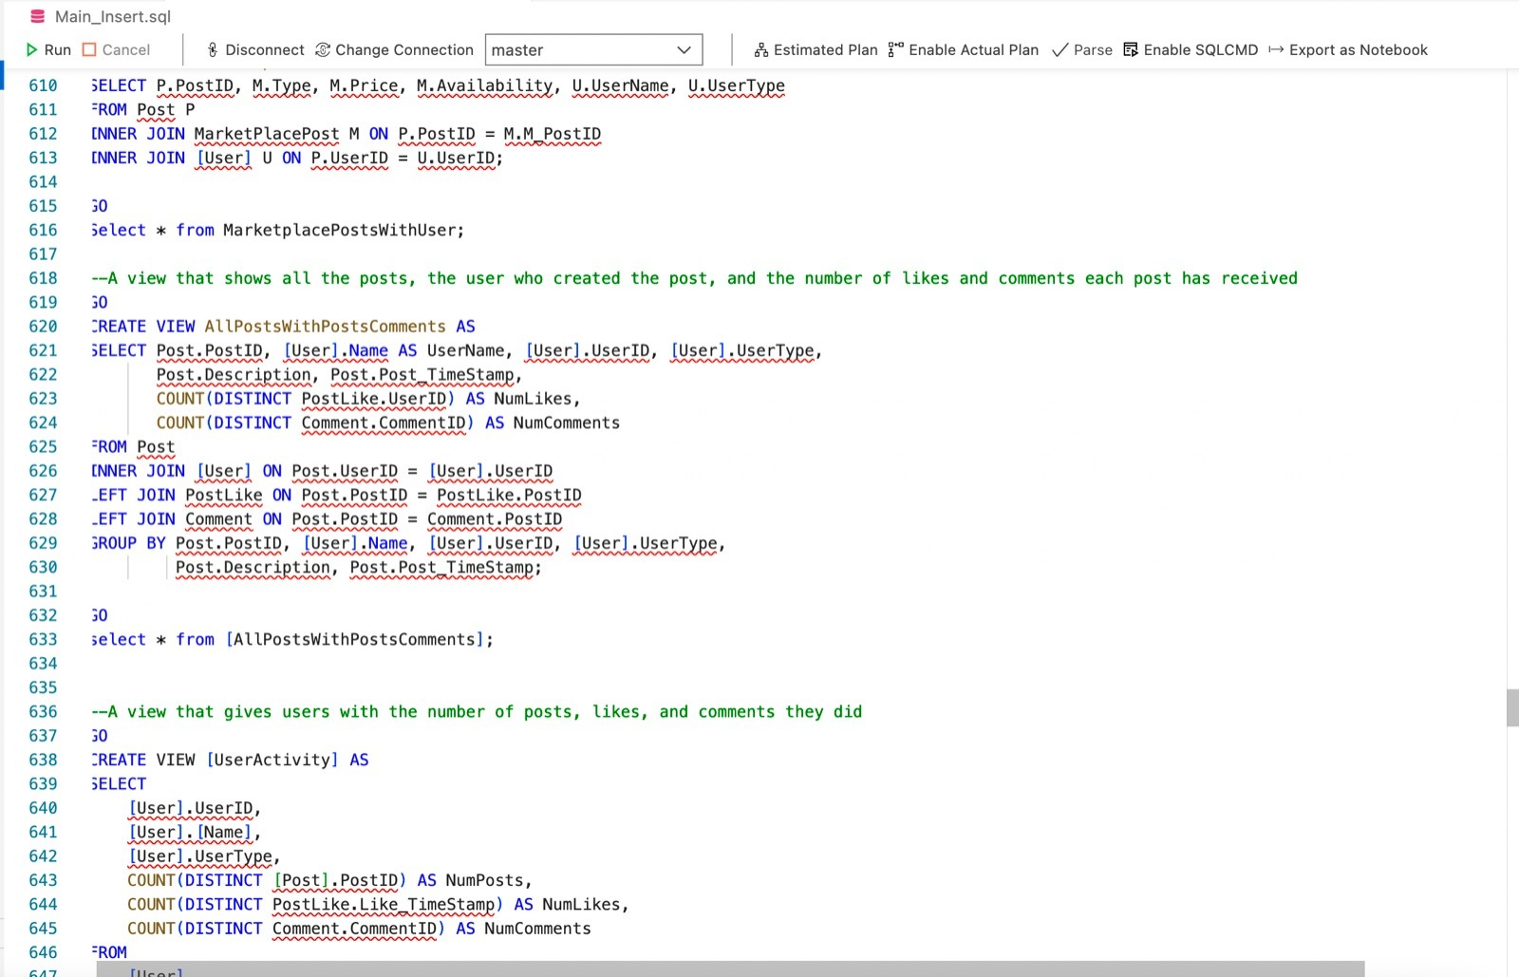
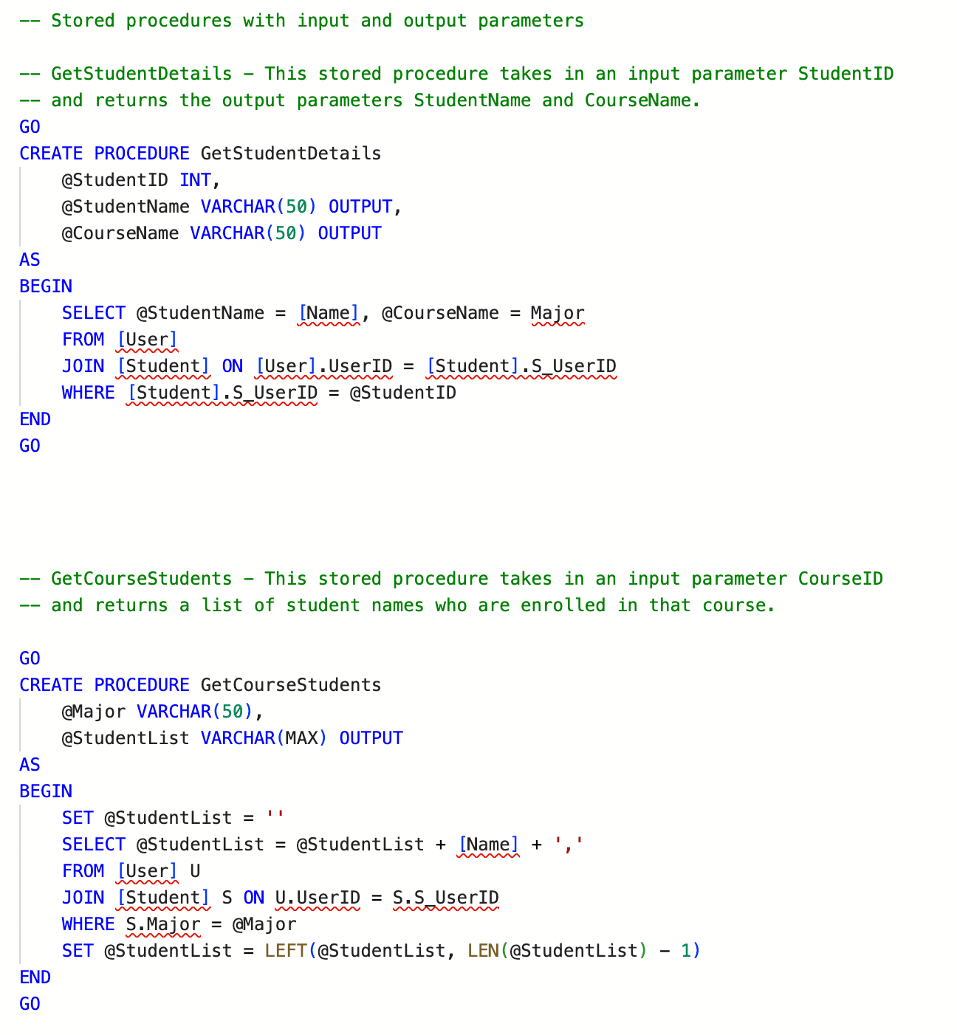
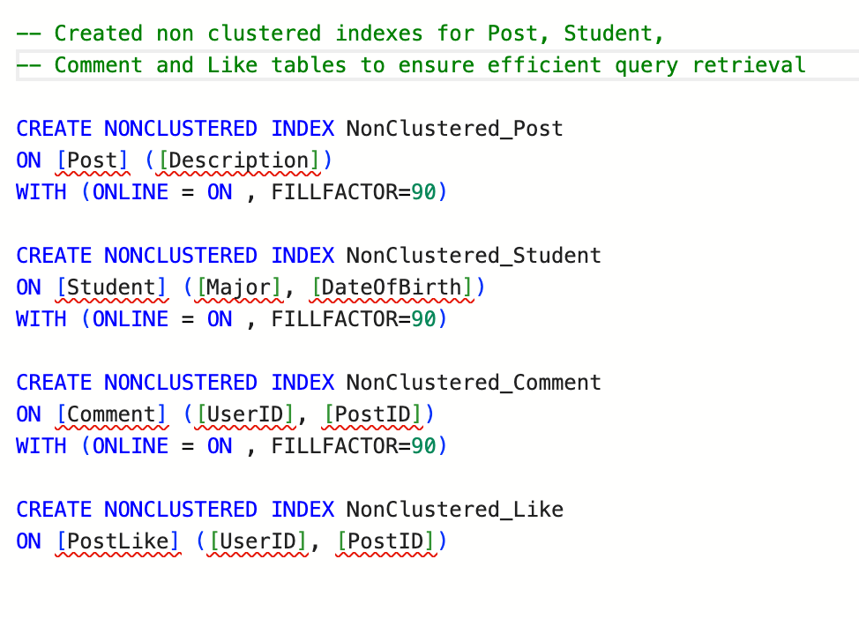
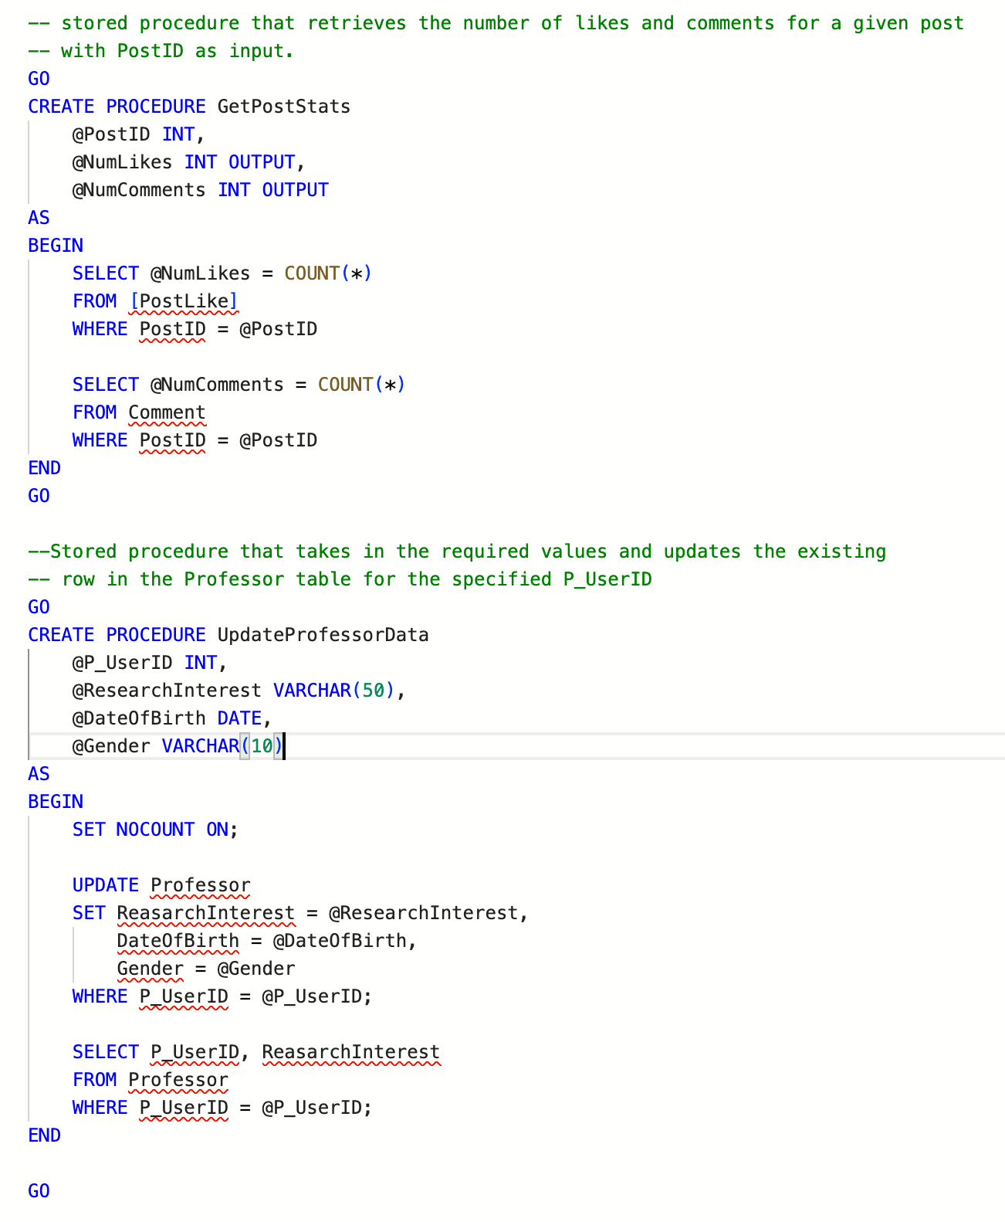
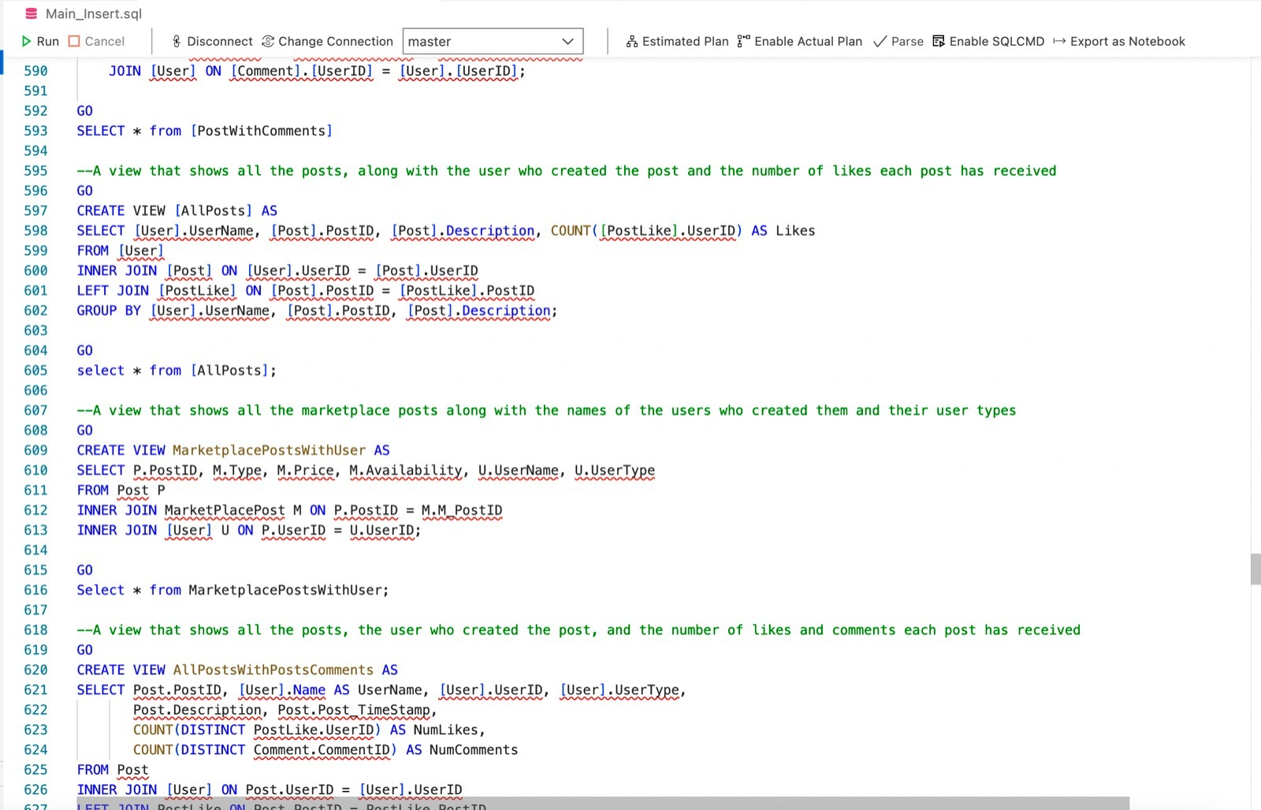
SQL Views, Non-clustered indexes, Stored Procedures

Slide 8
